Slide 1
Different Types Of CSS
SUBJECT NAME: INTERNET TECHNOLOGY
SUBJECT CODE: BCAC501
STUDENT NAME: SUDIP ROY
UNIV ROLL NO: 22601221107 UNIV REG NO: 212261001210080
DEPARTMENT: BCA
SEMESTER: 5TH

Slide 2
Different Types Of CSS
Sheikh Jamir Alam, Rahul Gorai, Sudip Roy, Srijan Banerjee

Slide 3
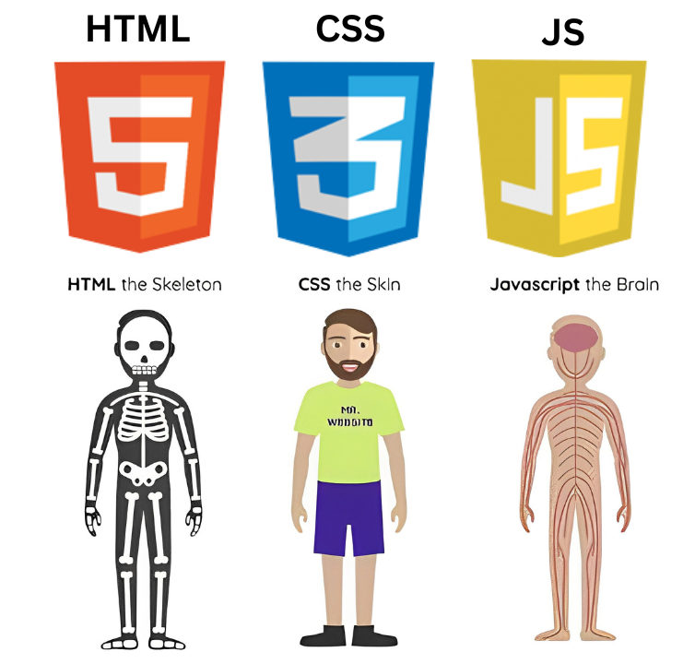
What is CSS ?
CSS (Cascading Style Sheet) describes the HTML elements which are displayed on screen. It allows us to add effects or animations to the website.
A webpage is made up of HTML, CSS and JavaScript. HTML is the skeleton (structure), CSS is the skin (appearance) and JavaScript is the brain (functionality).

Slide 4
Types of CSS
We can categorize CSS into 3 different types based on the way we use them.
There are 3 types of CSS which are below:
Inline CSS
Internal / Embedded CSS
External CSS

Slide 5
Inline CSS
Inline CSS is used to style a specific HTML element. For this CSS style, you’ll only need to add the style attribute to each HTML tag, without using selectors.
This CSS type is not really recommended, as each HTML tag needs to be styled individually. Managing your website may become too hard if you only use inline CSS.
01

Slide 6

Inline CSS
Here’s how you can use inline CSS :
<body style="background-color: black;">
<h1 style="color: white; padding: 30px;">
Hello World
</h1>
</body>

Slide 7
Internal CSS
Internal or embedded CSS requires you to add <style> tag in the <head> section of your HTML document.
This CSS style is an effective method of styling a single page. However, using this style for multiple pages is time-consuming as you need to put CSS rules on every page of your website.
02

Slide 8

Internal CSS
Here’s how you can use internal CSS :
<head>
<style>
h1 {
color: red;
background-color: black;
width: fit-content;
}
</style>
</head>

Slide 9
External CSS
With external CSS, you’ll link your web pages to an external .css file, which can be created by any text editor in your device.
This CSS type is a more efficient method, especially for styling a large website. By editing one .css file, you can change your entire site at once.
03

Slide 10

External CSS
Here’s how you can use external CSS :
body {
background-color: black;
}
h1 {
width: fit-content;
color: white;
background-color: aqua;
}
In the <head> section of your HTML sheet, add a reference to your external .css file right after <title> tag:
<link rel="stylesheet" type="text/css" href="style.css" />

Slide 11
THANK YOU

